Slide 1
Customer Service & Call Center Performance Analysis
Power BI Project
Tools Used: Power BI • Power Query • DAX
Prepared by: Aragonda Pavankumar

Slide 2
Project Objective
Analyze customer service interactions and call center performance.
Understand customer satisfaction, sentiment, channels, contact reasons, and SLA performance.
Compare workload and CSAT across call centers.
Identify improvement opportunities and provide data-driven recommendations.

Slide 3
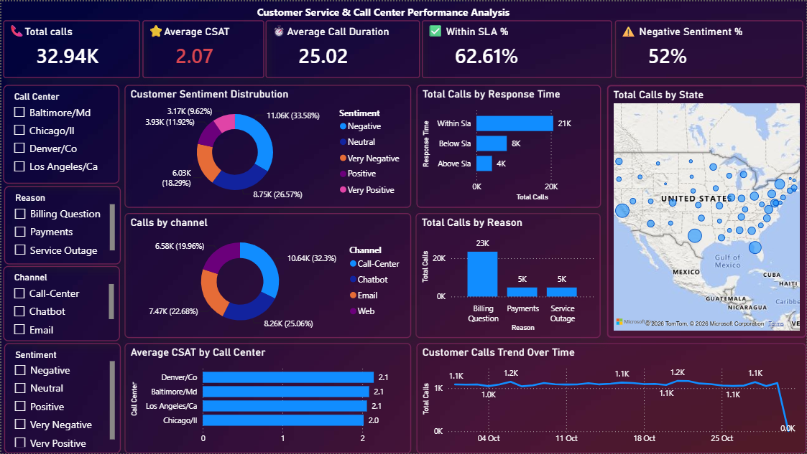
Dashboard

Slide 4
Dataset Overview
TOTAL RECORDS
32.94k
AVG CSAT
2.07 / 5
WITHIN SLA
62.61%
NEGATIVE SENTIMENT
52%
Key fields: Sentiment, CSAT Score, Call Timestamp, Reason, Channel, Response Time, Call Duration, Call Center, City, and State.
The dataset represents customer service interactions across multiple channels and call center locations.

Slide 5
Data Cleaning & Preparation
Imported the CSV dataset into Power BI using Power Query.
Promoted headers and verified column data types.
Converted Call Timestamp to the correct Date/Time format.
Checked duplicate records and cleaned text values.
Created a separate Date column and renamed columns for readability.
Created DAX measures for the major KPIs.

Slide 6
KPI Overview
TOTAL CALLS
32.94k
Customer interactions
AVERAGE CSAT
2.07 / 5
Low satisfaction
AVG CALL DURATION
25.02 min
Average handling time
WITHIN SLA
62.61%
610 interactions
NEGATIVE SENTIMENT
52%
539 interactions
Customer satisfaction is relatively low, while more than half of interactions have Negative or Very Negative sentiment.
39% of interactions are outside the Within SLA category.

Slide 7
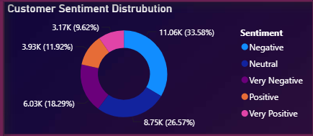
Customer Sentiment Analysis
Negative: 351 calls (35.1%)
Very Negative: 188 calls (18.8%)
Neutral: 246 calls (24.6%)
Positive: 124 calls (12.4%)
Very Positive: 91 calls (9.1%)
KEY INSIGHT
51.87%
Negative + Very Negative
More than half of customer interactions are associated with negative sentiment.
Only 21.54% are Positive or Very Positive, highlighting a major customer experience challenge.

Slide 8
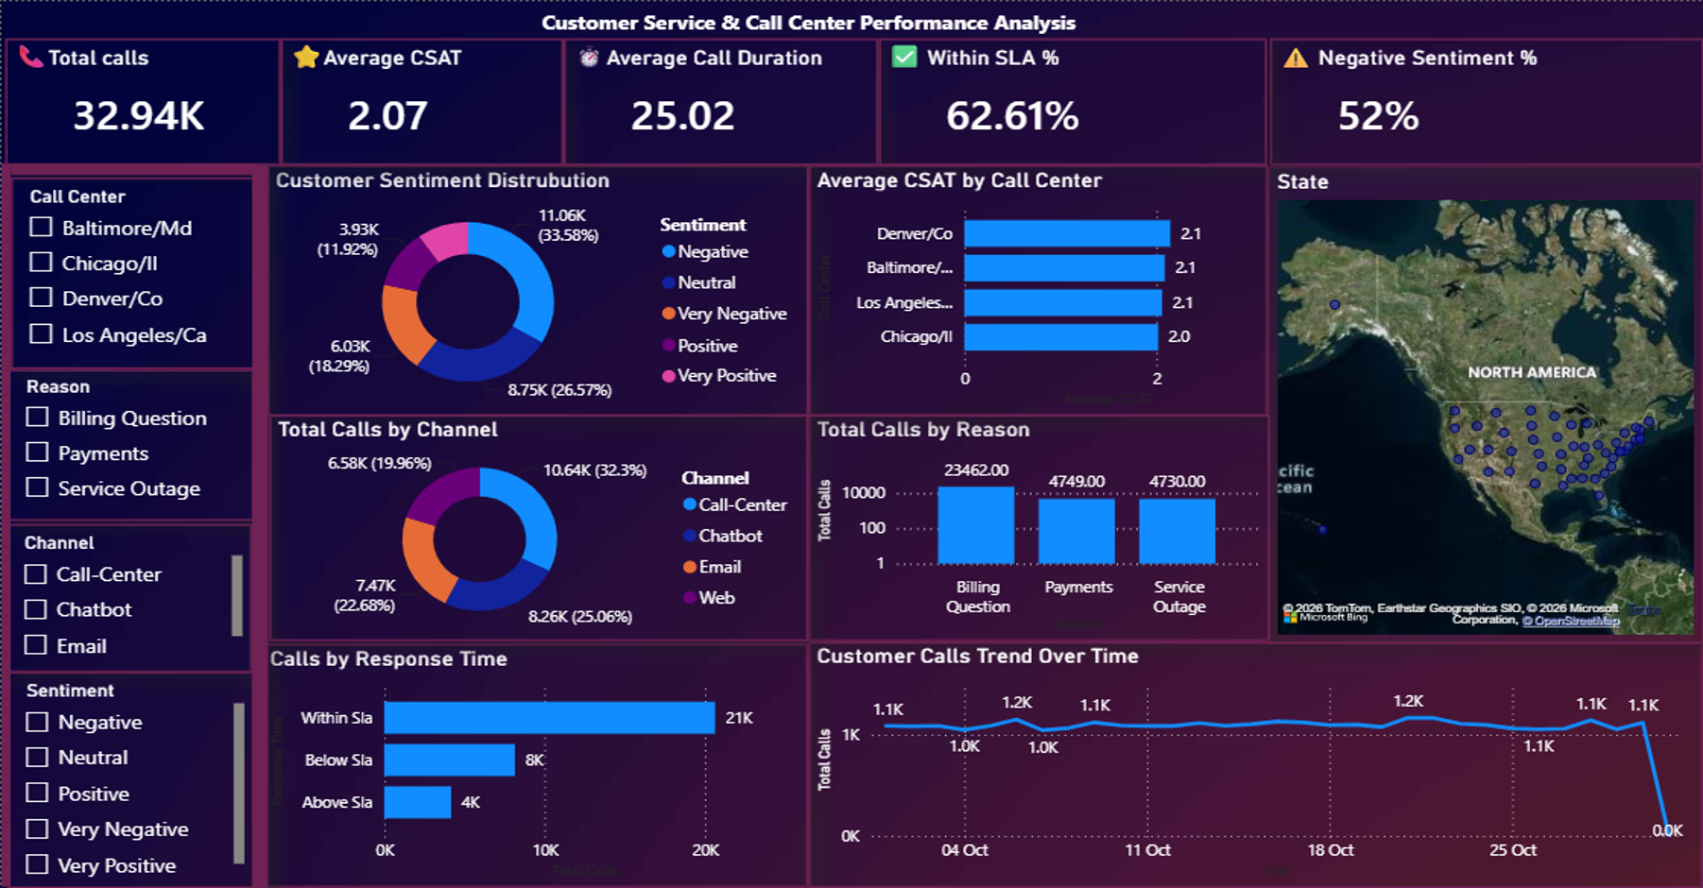
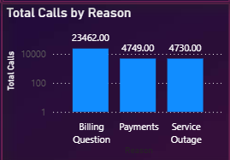
Channel & Customer Reason Analysis
Key Insight:
Billing Questions generate the highest customer contact volume.
Call-center delivers the highest satisfaction among three channels, while Chatbot,Web and Email need improvement.
Total Calls by Channel:
Call-Center: 10.64k
Chatbot:8.2k
Email:7.47k
Web: 6.58k
Total Calls by Reason:
Billing Question : 23462
Payments : 4749
Service Outage : 4730

Slide 9
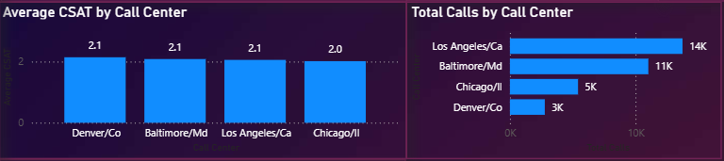
Call Center Performance
Total Calls:
Los Angeles: 14k
Baltimore: 11k
Chicago: 5k
Denver: 3k
Average CSAT:
Denver: 2.1
Baltimore: 2.1
Los Angeles: 2.1
Chicago: 2.0
Los Angeles (14K) and Baltimore (11K) handle the bulk of total workload. Denver handles the lowest volume (3K) , even though it shares the 2.1 CSAT score. and should be investigated for service quality and resolution issues.

Slide 10
Response Time & Call Trend
WITHIN SLA
20.63k (62.61%)
BELOW SLA
8.15k (24.74%)
ABOVE SLA
4.17k(12.65%)
• 62.61% of interactions are outside the Within SLA category.
• Daily call volume fluctuates, with the highest visible volume around 51 calls and the lowest around 20 calls.
• These patterns can support workforce planning and staffing during high-demand periods.

Slide 11
Top Key Insights
1. Overall Average CSAT is only 2.07 out of 5.
2. Negative and Very Negative interactions account for 51.87% of all calls.
3. Billing Questions are the leading reason for customer contact.
4. Call-Center,chatbot,Email has the highest workload; Web have the lowest workload (2.0).
5. Los Angeles (14K) and Baltimore (11K) handle the bulk of total workload. Denver handles the lowest volume (3K) , even though it shares the 2.1 CSAT score.
6. Chicago has the lowest CSAT score (2.0).
7. Only 62.61% of interactions are handled Within SLA.

Slide 12
Business Recommendations
Improve billing support through clearer invoices, FAQs, and self-service options.
Reduce negative sentiment by improving issue resolution and agent training.
Improve Web support, including faster escalation to human agents.
Investigate Chicago call center performance and provide targeted support.
Improve SLA compliance through better staffing, routing, and peak-demand planning.
Study successful practices from Los Angeles and apply them to lower-performing centers.

Slide 13
Conclusion
The analysis reveals significant opportunities to improve customer satisfaction and operational efficiency.
Main priorities: reducing negative sentiment, improving CSAT, enhancing billing support, strengthening digital channels, and increasing SLA performance.
The interactive Power BI dashboard enables ongoing monitoring and supports data-driven decision-making.
Thank You

